Slide 1
Goals – spike train analysis
Analysis of the Signal
Direction tuning
Linear kinematic model
Analysis of the noise
Neuron-behavior correlation
Models for interpreting correlation

Slide 2
Spike train analysis

Slide 3


Extracellular recording
2 second (real time)

Slide 4
Spike sorting - extracting spikes from extracellular recording

Slide 5
Now we can ‘forget’ from the analog signal
Reduced representation of the signal
Ignores real data
LFP
spike shape
Subthreshold activity
Ignores acquisition problems
Non stationarity
Noise – neural, other biological ,non-biological
Sorting errors

Slide 6

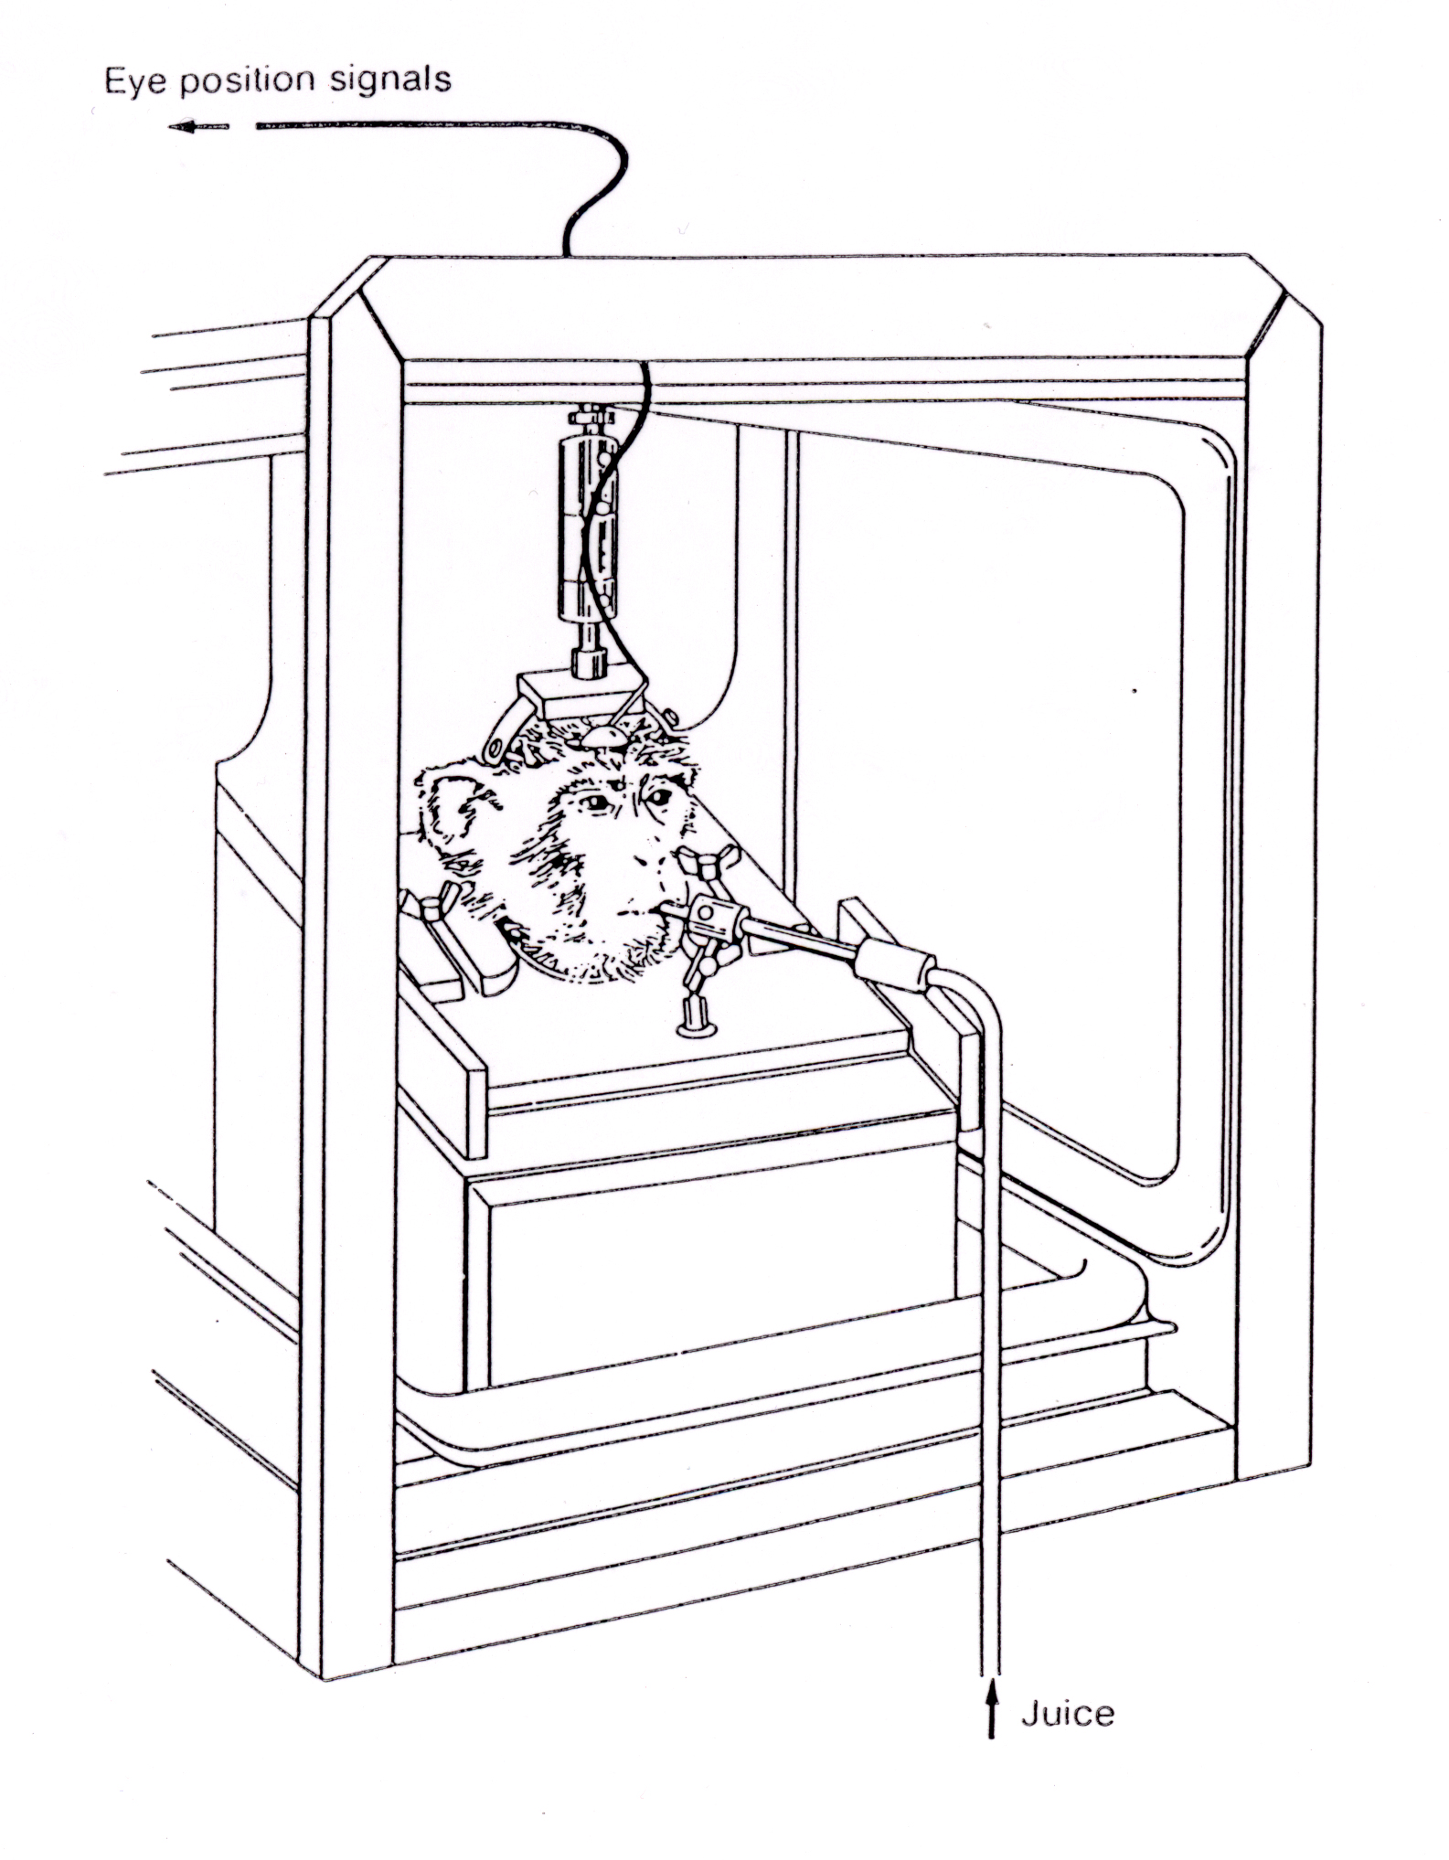
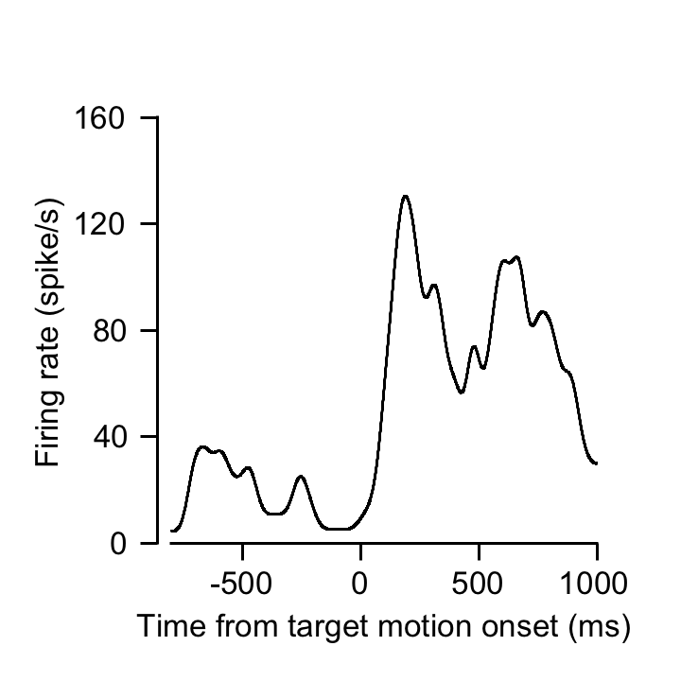

Example for spike train
X
Eye
1/5 real time
Target

Slide 7
Triggering spike and events
Event-related analysis of data
PSTH - peristimulus time histogram
Autocorrelation
Cross correlation
Reverse correlation
All these functions are basically the same

Slide 8
Correlating time series
Event 1
Event 2

Slide 9
Correlating time series
Event 1
Event 2
+1
+1
+1
 |  |  |  |  |  | 1 |  |  |  |  | 1 |  | 1

Slide 10
Correlating time series
Event 1
Event 2
+1
+1
+1
 |  | 1 |  |  |  | 2 |  |  | 1 |  | 1 |  | 1

Slide 11
Correlating time series
Event 1
Event 2
+1
+1
+1
 |  | 1 |  | 1 |  | 3 |  |  | 1 |  | 1 |  | 2

Slide 12
Correlating time series
Event 1
Event 2
PSTH
Event 1: Stimulus, Event 2: Spikes
Autocorrelation
Event 1 + Event 2 Spikes from the same cell
Cross correlation
Event 1: cell 1, Event 2: Cell 2
Reverse correlation: Event 1: cell Event 2: Behavior (Cont.)

Slide 13
Correlating time series
PSTH - Go to matlab

Slide 14
Smoothing
Go to matlab

Slide 15
Tuning curve

Slide 16
Tuning curve of V1 neuron

Slide 17
Tuning curve of neuron in the motor cortex
Go to matlab

Slide 18

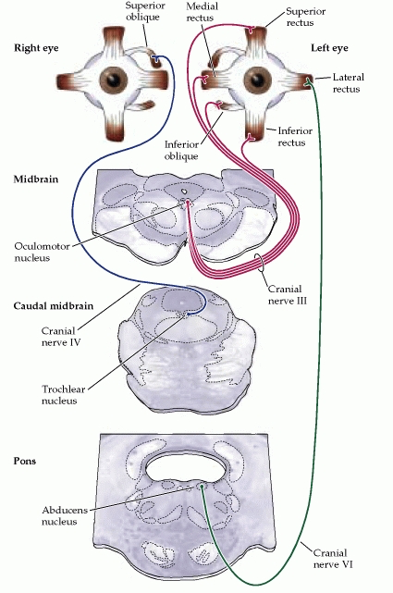
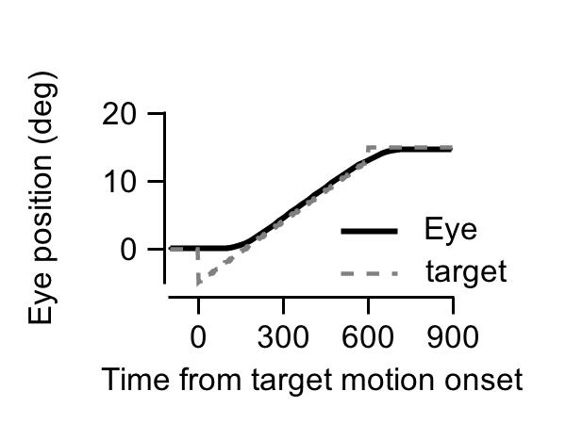
Activity of a motoneuron during pursuit
X
Eye
(ms)
1/10 real time
Target

Slide 19
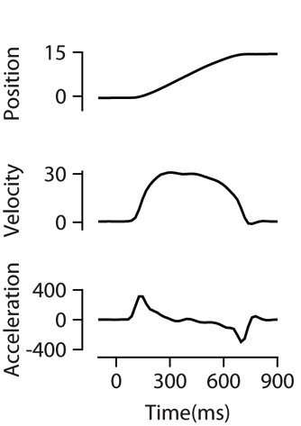
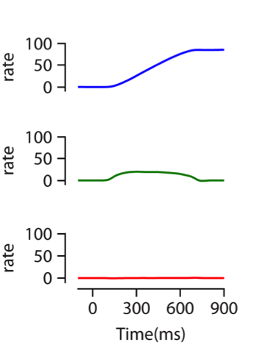
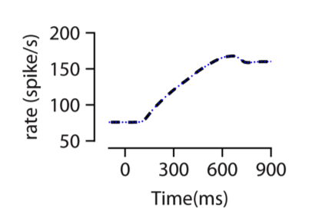
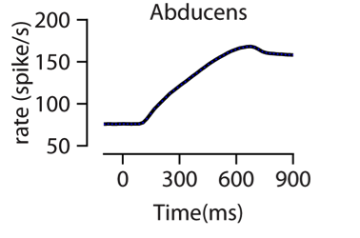
Linking movement kinematics and activity
Eye kinematics
Model
Firing rate
VAF = 0.992
Go to matlab

Slide 20
The signal in the noise
Neuron-behavior correlation
Correlation matrix
Interpretation of neuron-behavior correlation

Slide 21
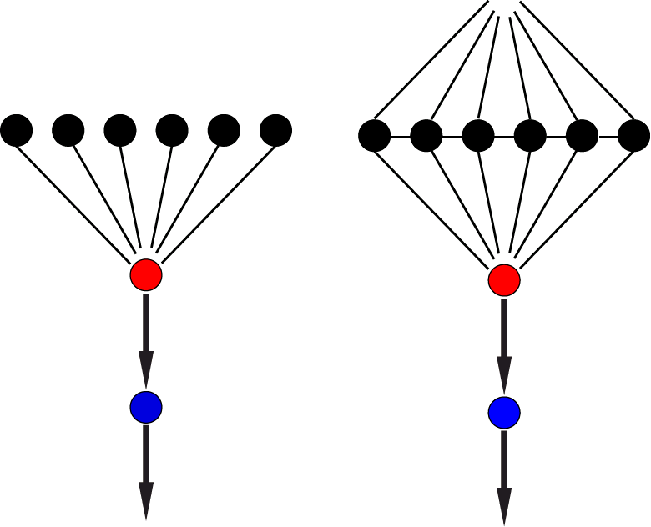
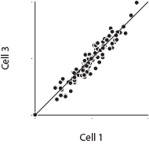
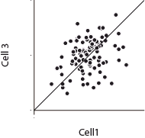
Independent vs. shared noise
Sources of variability in neurons and behavior
Independent noise
Shared noise
Behavior
Behavior
Rate
Rate
Behavior
Behavior

Slide 22
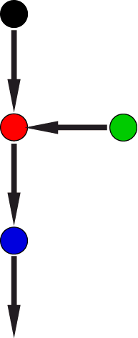
Sources of variability in neurons and behavior
Downstream noise
Without downstream
With downstream noise
Behavior
Behavior
Noise
Rate
Rate
Behavior
Go to matlab

Slide 23
Model for interpretation of neuron-behavior correlation
Shared noise (R_{NN})
Independent noise
Downstream noise (𝛽)
Noise

Slide 24
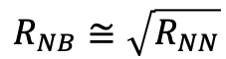
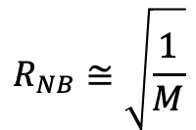
No downstream noise
Case 1: R_{NN} == 0
Case 2: M >> 1/R_{NN}
$$R_{NB}≅\sqrt{\frac{1}{M}}$$
$$R_{NB}≅\sqrt{R_{NN}}$$
Go to matlab

Slide 25
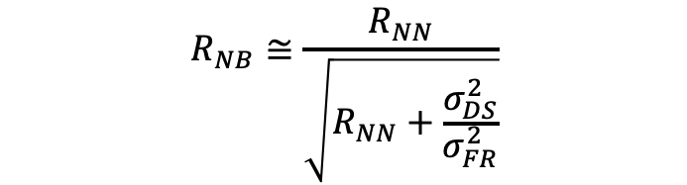
Downstream noise
Neuron-behavior correlation decreases with downstream noise
M >> 1/R_{NN}
$$R_{NB}≅\frac{R_{NN}}{\sqrt{R_{NN}+\frac{σ_{DS}^{2}}{σ_{FR}^{2}}}}$$
Go to matlab

Slide 26
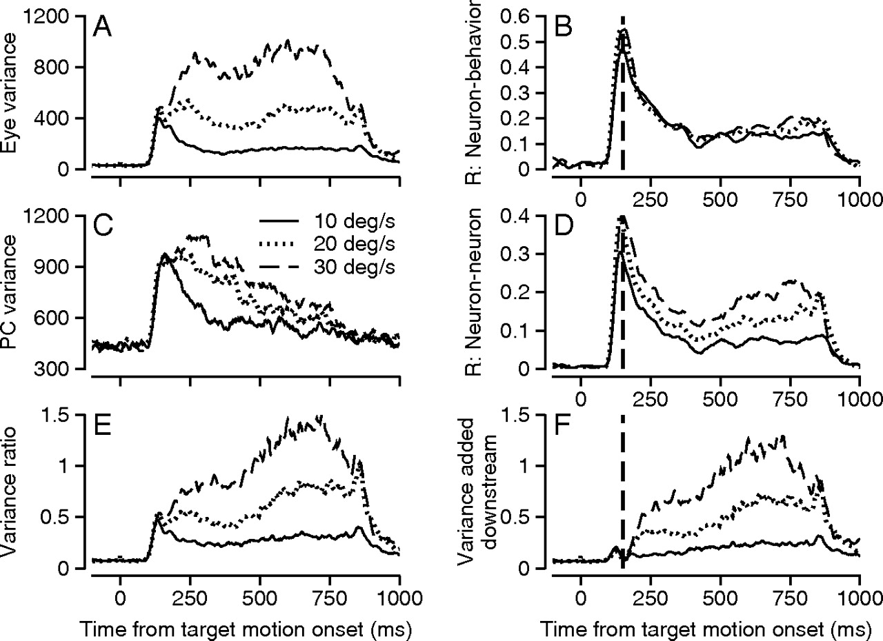
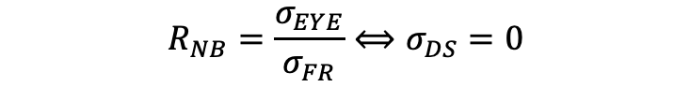
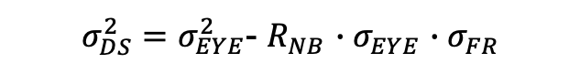
Qualitative and quantitative measures of downstream noise
$$R_{NB}=\frac{σ_{EYE}}{σ_{FR}}⟺σ_{DS}=0$$
$σ_{DS}^{2}=σ_{EYE}^{2}$- $R_{NB}$ ${∙σ}_{EYE}^{}$ ${∙σ}_{FR}^{}$
Estimating Downstream noise
Go to matlab

Slide 27
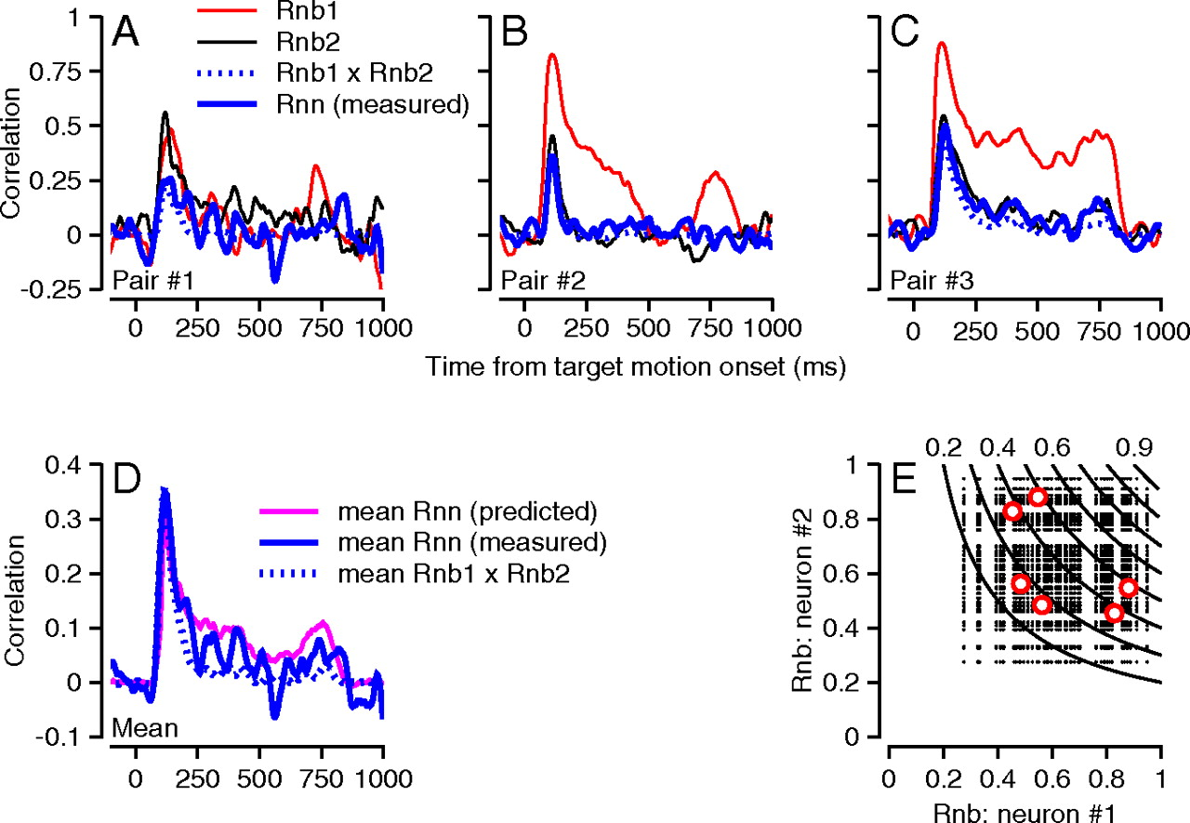
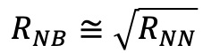
The relation between neuron-neuron and neuron behavior correlation
$$R_{NB}≅\sqrt{R_{NN}}$$
R_{NN} = R_{NB1} * R_{NB2}

Slide 28
Summary
Analysis of the signal
Extracellular recordings
Triggering spike and events
PSTH and smoothing
Tuning curves
Linear kinematic model
Analysis of the noise
Neuron-behavior correlation
Model interpretation of neuron-behavior correlation
Shared, independent and downstream noise
Neuron-neuron correlation

